Slide 1
PHP Basics
Prepared By
Mahadi Hassan

Slide 2
What is PHP ?
PHP stands for PHP: Hypertext Preprocessor.
It is a server-side scripting language mainly used to create dynamic web pages and web applications.

Slide 3
Why will we learn PHP in Web Development ?
We Learn PHP for:
Server-side scripting language
Creates dynamic websites
Handles forms, sessions & login
Connects with databases (MySQL)
Used in real projects (WordPress, Laravel)
Easy to learn & widely supported

Slide 4
Key Feature
Open-source & free
Server-side scripting
Easy to learn
Platform independent
Supports databases (MySQL, SQLite)
Fast & secure
Embedded with HTML
Large community support

Slide 5
Variables
Variables
Store data values
Start with $ sign
Example: $name = "Mahadi";

Slide 6
Constants
Constants
Fixed values (cannot change)
Defined using define() or const
Example: define("SITE_NAME", "My Website");
Data Types
String ("Hello")
Integer (10)
Float (3.14)
Boolean (true / false)
Array ([1, 2, 3])
Object
NULL

Slide 7
Data Types
Data Types
String ("Hello")
Integer (10)
Float (3.14)
Boolean (true / false)
Array ([1, 2, 3])
Object
NULL

Slide 8
Operators
Arithmetic Operators
Addition = +
Subtraction = -
Multiplication = *
Division = /
Modulus = %

Slide 9
Operators
Comparison Operators
Equal : ==
Not equal : !=
Greater than : >
Less than: <
Greater or equal: >=
Less or equal: <=

Slide 10
Operator
Logical Operators
AND = &&
OR = ||
NOT= !
Assignment Operators
= , += , -= , *= , /=
Increment / Decrement
++ , --

Slide 11
Control Structures (if-else)
IF-Else
Example:
If condition
NO
YES
Execute this
Execute this

Slide 12
Control Structures (switch)
Switch Control Statement
Switch:
Case 1
True
Statement
break;
False
Case 2
True
Statement
break;
Next Statement
False
default
Statement
break;

Slide 13
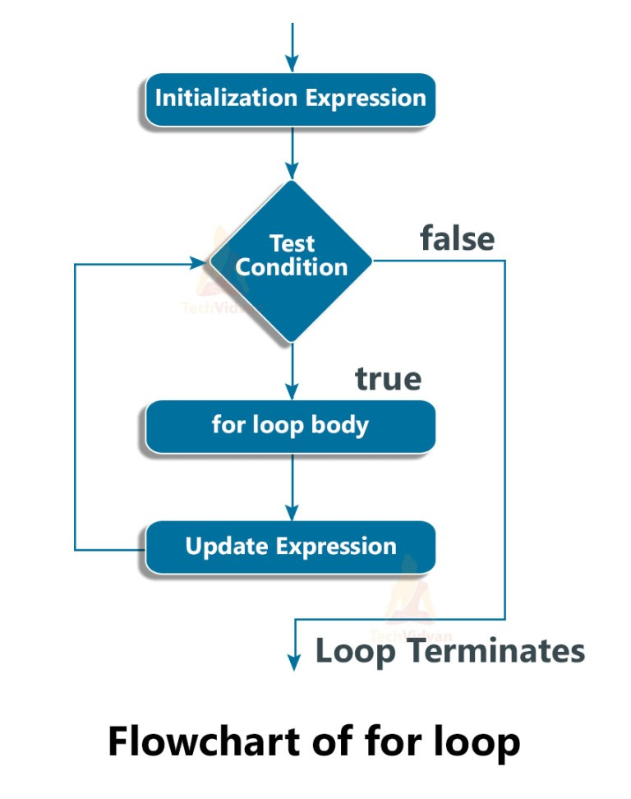
Control Structures (loops)
Loops

Slide 14
Functions
What is a Function?
A reusable block of code that perform
Executes a specific task
Improves code readability & reusability

Slide 15
Functions
Types of Functions in PHP
Built-in Functions
Predefined functions provided by PHP
Example: strlen(), date()
User-Defined Functions
Functions created by the programmer
Example: function add() {}
Functions with Parameters
Accept input values
Example: add($a, $b)
Functions with Return Value
Return a result
Example: return $sum;

Slide 16
Functions
Anonymous Functions
Functions without a name
Example: $x = function() {};
Recursive Functions
A function that calls itself
Example: factorial()
Arrow Functions (PHP 7.4+)
Short syntax for anonymous functions
Example: fn($x) => $x*$x
Variable Functions
Function called using a variable name
Example: $func();

Slide 17
Arrays (Indexed)
Arrays hold multiple values in a single variable.
2 | 4 | 8 | 12 | 16
arr
0 | 1 | 2 | 3 | 4

Slide 18
Arrays (Associative)
Associative Array : An associative array is a collection of key–value pairs, where each key is unique and maps to a value.
$student = [
"name" => "Amit",
"age" => 17,
"class" => "12th"
];

Slide 19
Arrays (Multidimensional)
Multidimensional Array : A multidimensional array is an array that contains one or more arrays inside it.
It is used to store data in a table-like or matrix form.
 | 1 | 2 | 3 | 4
1
2
3
 | name | age | height | width
P1
P2
p3

Slide 20
String Manipulation
String Manipulation
PHP provides many functions to create, modify, and inspect strings.
Examples:
$str = "Hello World";
echo strlen($str); // 11
echo strtoupper($str); // HELLO WORLD
echo strtolower($str); // hello world
echo str_replace("World", "PHP", $str); // Hello PHP
echo substr($str, 6, 5); // World

Slide 21
String Manipulation
Other Useful Functions:
trim() → remove spaces
strpos() → find position of substring
explode() → split string into array
implode() → join array into string

Slide 22
Regular Expressions
Regular Expressions (Regex)
Pattern matching in strings.
preg_match() → check if pattern exists.
preg_replace() → replace pattern.
preg_split() → split by pattern.
Examples:
$str = "My email is test@example.com";
if(preg_match("/[a-z0-9._%+-]+@[a-z0-9.-]+\.[a-z]{2,4}/", $str)){
echo "Valid email";
}
echo preg_replace("/\d/", "#", "Phone: 01712345678");
print_r(preg_split("/\s+/", "PHP is fun"));

Slide 23
File Handling (Read, Write, Append)
PHP File Handling
PHP allows you to create, read, write, and append files.
1. Write to a File
file_put_contents("example.txt", "Hello, PHP!");
Creates or overwrites the file.
2. Append to a File
file_put_contents("example.txt", "\nAppended Text", FILE_APPEND);
Adds new content without deleting existing data.

Slide 24
File Handling (Read, Write, Append)
3. Read from a File
echo file_get_contents("example.txt"); // Read entire file
$handle = fopen("example.txt", "r"); // Read line by line
while(!feof($handle)){
echo fgets($handle) . "<br>";
}
fclose($handle);

Slide 25
Error and Exception Handling
PHP provides ways to detect, handle, and manage errors in your code.
1. Error Handling
PHP has built-in error types:Notice → Minor issue, script continues.Warning → Non-fatal, script continues.Fatal Error → Stops script execution.
Example:
echo $undefined_variable;
function customError($errno, $errstr) {
echo "Error [$errno]: $errstr";
}
set_error_handler("customError");
echo 10/0;

Slide 26
Error and Exception Handling
2. Exception Handling
Use try-catch blocks to handle exceptions.
Exceptions are objects, can carry custom messages.
Example:
try {
if(!file_exists("test.txt")){
throw new Exception("File not found!");
}} catch (Exception $e) {
echo "Caught Exception: " . $e->getMessage();
} finally {
echo " - Execution completed.";
}

Slide 27
Object-Oriented Programming (OOP) in PHP
Definition:
OOP is a programming paradigm that organizes code using classes and objects, making it more modular, reusable, and maintainable.
Key Concepts of OOP
Class
  A blueprint or template for creating objects.
  Defines properties (variables) and methods (functions).
Object
  An instance of a class.
  Holds actual values for the class properties.
Properties & Methods
  Property: Variable defined in a class.
  Method: Function defined inside a class.
Constructor
  Special method __construct() used to initialize objects automatically when created.

Slide 28
PHP and Databases
Definition:
PHP can interact with databases to store, retrieve, update, and delete data, enabling dynamic web applications.
Common Databases with PHP
MySQL / MariaDB – Most popular relational database.
PostgreSQL – Advanced SQL features.
SQLite – Lightweight file-based database.
NoSQL databases (e.g., MongoDB) – For flexible, schema-less data.

Slide 29
What is Database?
A database is an organized collection of data that is stored electronically and can be easily accessed, managed, updated, and retrieved.

Slide 30
Types of Databases Based on Data Structure
1. Structured Database
Data is stored in a fixed format (rows & columns)
Schema is predefined
Easy to search and manage
Example: MySQL, PostgreSQL, Oracle etc.
2. Semi-Structured Database
Data has some structure, but not rigid
Uses tags or key-value pairs
Schema can change easily
Example: JSON, XML etc.

Slide 31
Types of Databases Based on Data Structure
3. Unstructured Database
Data has no fixed structure
Stores raw data
Text, image, video etc

Slide 32
Structured Database ( MySQL)
well-defined format
tables with rows and columns
MySQL is an RDBMS (Relational Database Management System).
It uses SQL (Structured Query Language).
Data is stored in tables with a fixed schema.

Slide 33
Structured Database ( MySQL)
What is relation?
A relation is simply a table that stores data.
What is relationship?
Connection between tables.

Slide 34
Structured Database ( MySQL)
Key Features of Relational Databases
Table-based structure
Fixed schema
Data integrity
ACID properties
Supports joins

Slide 35
ER-Diagram (Entity-Relationship Diagram)
An ER Diagram is a visual representation of a database that shows entities, their attributes, and the relationships between them.

Slide 36
ER-Diagram (Continue)
Main Components of an ER Diagram
1. Entity
An entity is a real-world object.Represented by a rectangle.
Examples: Student, Teacher, Course
2. Attribute
An attribute describes an entity.Represented by an oval.
Types of Attributes:
Simple: name, age
Composite: full_name (first + last)
Primary key: student_id (underlined)
Multivalued: phone numbers
Derived: age (from date_of_birth)

Slide 37
ER-Diagram (Continue)
3. Relationship
Shows how entities are connected.Represented by a diamond.
Examples: Student enrolls in Course
Types of Relationships
Type | Meaning
One-to-One (1:1) | One entity relates to one
One-to-Many (1:N) | One relates to many
Many-to-Many (M:N) | Many relate to many

Slide 38
ER-Diagram (Continue)
Purpose of ER Diagram
Helps design database structure
Reduces errors before implementation
Makes database easy to understand
Used before creating tables

Slide 39
Connecting to MySQL using MySQLi
Using MySQLi
Supports procedural and object-oriented styles.
Example (Procedural):
$conn = mysqli_connect("localhost", "username", "password", "database");
if (!$conn)
{
die("Connection failed: " . mysqli_connect_error());
}
echo "Connected successfully";

Slide 40
Connecting to MySQL using MySQLi
Example (Object-Oriented):
$conn = new mysqli("localhost", "username", "password", "database");
if ($conn->connect_error) {
die("Connection failed: " . $conn->connect_error);
}
echo "Connected successfully";

Slide 41
CRUD Operations (Create, Read, Update, Delete)
CRUD refers to the basic operations you can perform on a database:
C – Create
R – Read
U – Update
D – Delete

Slide 42
CRUD Operations (Create, Read, Update, Delete)
1. Create (Insert Data)
$sql = "INSERT INTO users (name, email) VALUES ('Mahadi', 'mahadi@example.com')";
$conn->query($sql);
2. Read (Retrieve Data)
$sql = "SELECT * FROM users";
$result = $conn->query($sql);
while($row = $result->fetch_assoc()){
echo $row['name'] . "<br>";
}

Slide 43
CRUD Operations (Create, Read, Update, Delete)
3. Update (Modify Data)
$sql = "UPDATE users SET email='newemail@example.com' WHERE name='Mahadi'";
$conn->query($sql);
4. Delete (Remove Data)
$sql = "DELETE FROM users WHERE name='Mahadi'";
$conn->query($sql);

Slide 44
Prepared Statements and SQL Injection Prevention
SQL Injection
Malicious SQL inserted via user input.
Can expose, modify, or delete data.
Prepared Statements
Separate SQL code from user data.
User input is bound safely, preventing execution as SQL.
Example (PDO):
$stmt = $conn->prepare("SELECT * FROM users WHERE email=?");
$stmt->execute([$email]);

Slide 45
Database Transactions
Definition:
A database transaction is a set of SQL operations executed as a single unit. Either all succeed or all fail, ensuring data integrity.
Key Concepts
BEGIN / START TRANSACTION – Start a transaction.
COMMIT – Save all changes permanently.
ROLLBACK – Undo changes if an error occurs.

Slide 46
Database Transactions
try {
$conn->beginTransaction();
$conn->exec("INSERT INTO accounts (name, balance) VALUES ('Alice', 1000)");
$conn->exec("INSERT INTO accounts (name, balance) VALUES ('Bob', 500)");
$conn->commit(); // All changes saved
} catch (Exception $e) {
$conn->rollback(); // Undo all changes
echo "Transaction failed: " . $e->getMessage();
}

Slide 47
Handling Relationships (One-to-Many, Many-to-Many)
Definition:
Database relationships define how tables are connected to each other in a relational database.
1. One-to-Many (1:N)
One record in a table relates to many records in another table.
Example: Category → Products
Tables:
categories → id, name
products → id, name, category_id
Query Example (PDO):
SELECT * FROM products WHERE category_id = 1;

Slide 48
Handling Relationships
2. Many-to-Many (M:N)
Many records in a table relate to many records in another table.
Requires a junction table.
Example: Students ↔ Courses

Slide 49
Advanced PHP Features
Sessions and Cookies
Authentication and Authorization
File Uploads and Validation
Working with APIs (RESTful APIs, JSON, XML)
cURL for HTTP Requests
PHP Streams and File System Functions

Slide 50
PHP Frameworks and Libraries
Introduction to Popular Frameworks (Laravel, Symfony, CodeIgniter)
MVC Architecture
Composer for Dependency Management
Using Libraries (e.g., Guzzle, PHPMailer)

Slide 51
Web Development with PHP
Form Handling and Validation
Working with HTML, CSS, and JavaScript
AJAX and PHP Integration
Building Dynamic Web Pages
Template Engines (e.g., Blade, Twig)

Slide 52
Security in PHP
Input Validation and Sanitization
Cross-Site Scripting (XSS) Prevention
Cross-Site Request Forgery (CSRF) Protection
Password Hashing and Encryption
Secure Session Management

Slide 53
API Development and Consumption

